Slide 1
Lesson 304.6 - SQL JOIN Tables

Slide 2
Section 1
______________________________________
SQL JOIN Tables
Learning Objectives:
This presentation explains how to use SQL JOINS with syntax, visual illustrations, and examples.
By the end of this lesson, learners will be able to:
Describe the JOIN Predicate.
Demonstrate the inner JOIN, left JOIN, right JOIN, self JOIN, cross JOIN, and Union.

Slide 3
Prerequisite
Note: We will utilize a “classicmodels” database for demonstrations and examples in this presentation.

Slide 4
Table of Contents
Overview of Joining Tables
Types of Joins
General JOIN Syntax
Overview of INNER JOIN clause
Syntax of the INNER JOIN
Avoid ambiguous column error in JOIN
Challenge for learners
Overview of LEFT JOIN
Using LEFT JOIN
Syntax of the LEFT JOIN
Overview of RIGHT JOIN
Overview of CROSS JOIN
Overview of SELF JOIN
Overview of FULL JOIN
Overview of Union operator
UNION vs. JOIN
Joining without JOIN

Slide 5
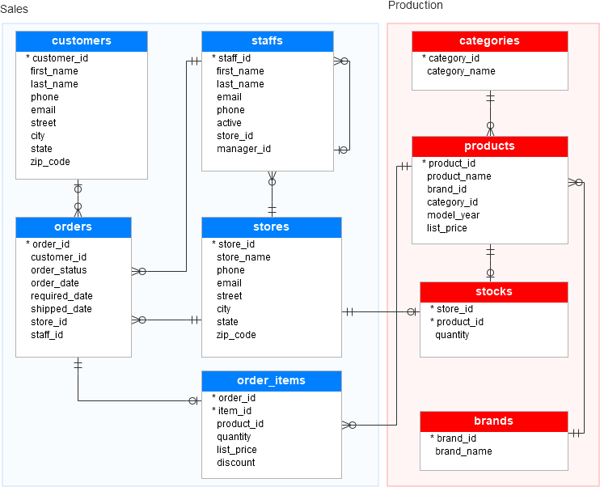
Overview of Joining Tables
Bike Stores database diagram
Question:
We have used SELECT statement to query data from a single table. How do we query data from multiple tables that are related by one or more primary key/foreign key relationships?
For example, in the database diagrammed, there are nine tables; all are related, either directly or indirectly.
Some of the connections go through junction tables, defining many-to-many relationships.
Answer: A JOIN predicate is used to combine rows from two or more tables, based on a related column between them.
image source: sqlservertutorial.net

Slide 6
Types of JOINS
JOIN predicate allow us to walk through the relationships between two or more tables in the FROM clause.
JOINS are queries that combine the data of multiple tables based on their common columns (primary key and foreign key) and constraints to produce a combined result set.
The following JOINS are supported by MySQL:
Inner JOIN
Left JOIN
Right JOIN
Cross JOIN
Self JOIN
Note that MySQL does not support the full Outer JOIN.

Slide 7
General JOIN Syntax
Select <column-names>
FROM <left table> [join type] JOIN <right table> ON <join predicate> ….
The join predicate is a boolean expression, specifying criteria for matching rows between two or more tables. Most often, the predicate is based on key relationships, but other boolean expressions can be used.
The Join predicate often requires us to use table aliases to distinguish field names.

Slide 8
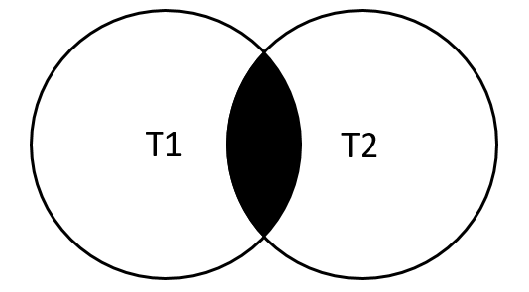
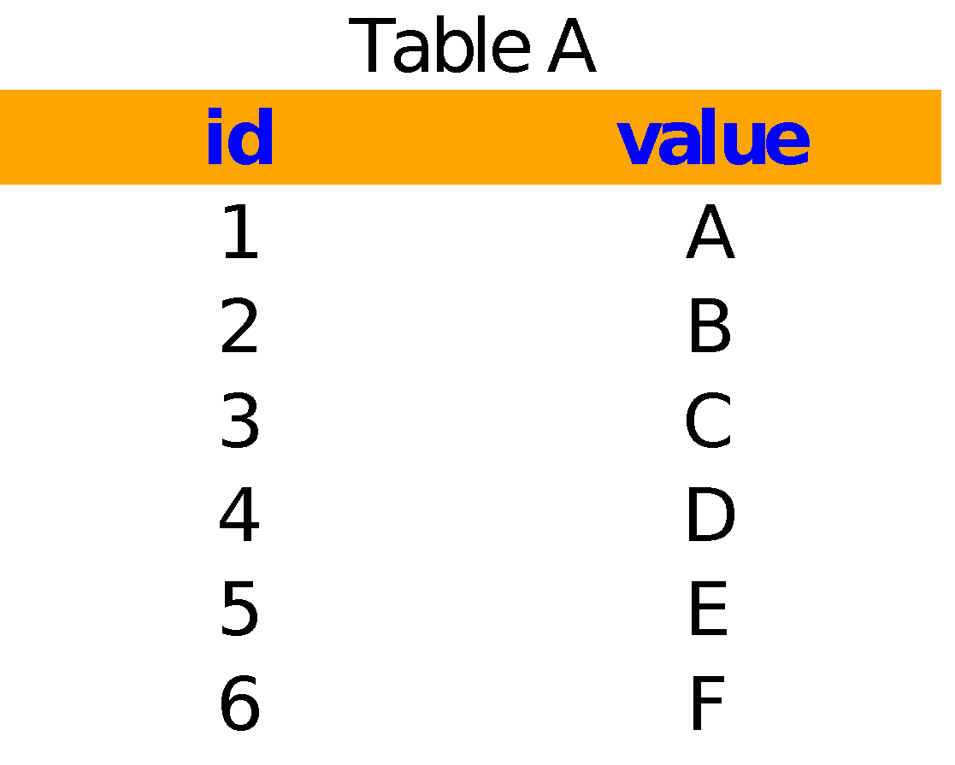

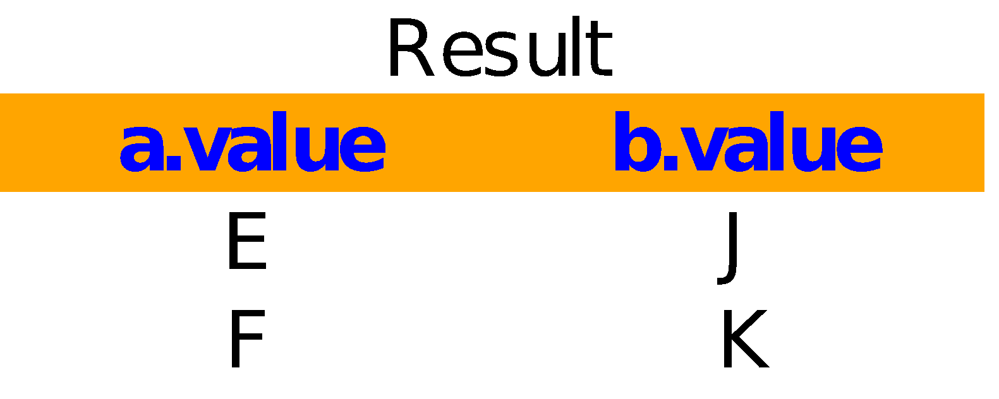
Overview of INNER JOIN Clause
The INNER JOIN clause joins two or more tables based on a condition, which is known as a join predicate.
For inner joins, rows from the left and right tables will appear in the output, if and only if they both satisfy the join predicate.
The INNER JOIN includes only matching rows from both tables.
Visual illustration
img src: databasestar.com
select a.value, b.value from TableA a join TableB b on a.id=b.id;
inner join
on a.id=b.id
2 rows satisfy the join predicate

Slide 9
Syntax of the INNER JOIN
The following shows the basic syntax of the “INNER JOIN” clause that joins tables: table_1 and table_2.
SELECT column_list
FROM table_1
INNER JOIN table_2 ON join_condition;
The INNER JOIN clause compares each row from the first table with every row from the second table.
When the join predicate is based on equality between two columns with the same name, SQL gives us a shortcut. You can use the USING clause instead as shown below:
SELECT column_list
FROM table_1
INNER JOIN table_2 USING (column_name);
Both queries will give the identical result.

Slide 10
Ambiguous Column Errors in JOIN
If you join multiple tables that have the same column name, you have to use a table qualifier to refer to that column in the SELECT statement to avoid ambiguous column errors.
For example, if both Table1 and Table2 have the same column named City in the SELECT statement, you have to refer to the City column using the table qualifiers as Table1.City or Table2.City
To save time typing the table qualifiers, you can use table aliases in the query. For example, you can give the verylongtablename table an alias T and refer to its columns using T.column instead of verylongtablename.column.

Slide 11
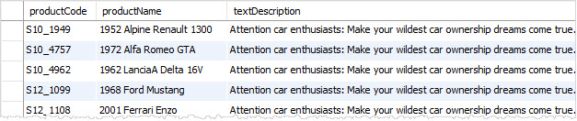
Example 1: INNER JOIN
If you want to get the product code and product name from the products table, or the text description of product lines from the productlines table, you need to select data from both tables and match rows by comparing the productline column from the products table with the productline column from the productlines table, as shown in the following query.
SELECT T1.productCode, T1.productName, T2.textDescription
FROM products T1
INNER JOIN productlines T2 ON T1.productline = T2.productline;
Output:

Slide 12
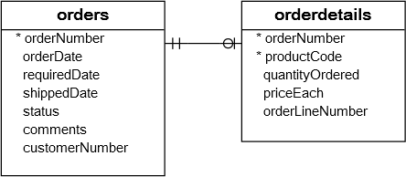
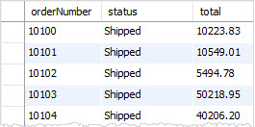
Example 2: INNER JOIN with GROUP BY Clause
Consider the orders and orderdetails tables: 🠆
We can get the order number, order status, and total sales from the orders and orderdetails tables using the INNER JOIN clause with the GROUP BY clause, as shown in the query below:
SELECT T1.orderNumber, STATUS, SUM(quantityOrdered * priceEach) total
FRO
M orders AS T1
INNER JOIN orderdetails AS T2 ON T1.orderNumber = T2.orderNumber
GROUP BY T1.orderNumber;
Output:
We can write the above query with the “using” keyword. See the next slide for a demonstration.
continue…

Slide 13
Example 2: INNER JOIN with GROUP BY Clause (continued)
We can write the query on the previous page with the “using” keyword:
SELECT T1.orderNumber, STATUS, SUM(quantityOrdered * priceEach) total
FROM orders AS T1
INNER JOIN orderdetails AS T2 using(orderNumber)
GROUP BY T1.orderNumber;

Slide 14
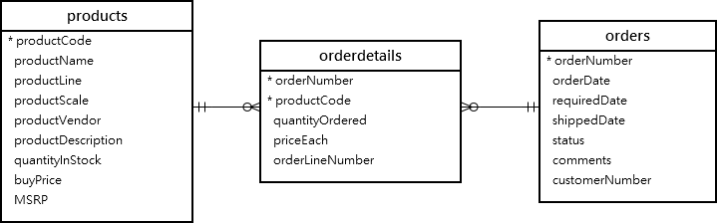
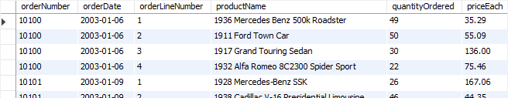
Example 3: INNER JOIN – Join Three Tables
Consider the products, orders and orderdetails tables. The query below is using two INNER JOIN clauses to join three tables: orders, orderdetails, and products.
🠆
SELECT orderNumber, orderDate, orderLineNumber, productName, quantityOrdered, priceEach
FROM orders
INNER JOIN orderdetails USING (orderNumber)
INNER JOIN products USING (productCode)
ORDER BY orderNumber, orderLineNumber;
This picture shows the partial output

Slide 15
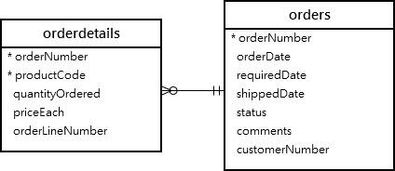
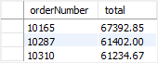
Example 4: INNER JOIN With GROUP BY and Having Clause
Let’s take a look at the orders and orderdetails tables from the classicmodels database.
The following query finds sales orders whose value total is greater than $60K.
🠆
SELECT orderNumber, SUM(priceEach * quantityOrdered) as total
FROM orderdetails
INNER JOIN orders USING (orderNumber)
GROUP BY orderNumber HAVING SUM(priceEach * quantityOrdered) > 60000;
It returns three rows, which means that there are three sales orders whose total values total greater than $60K.

Slide 16
Natural JOIN
The INNER JOIN is also called a Natural JOIN. We could also write the previous query without INNER or using a keyword. See below:
select a.value, b.value from A a natural join B b;
For a Natural JOIN, the JOIN predicate is formed “naturally” based on fields from both tables with matching names. Tables A and B both have an “id” field; therefore, the Natural JOIN forms the predicate based on the equality of A.id and B.id.
You should be aware of Natural JOIN syntax in case you encounter it, but its use is strongly discouraged. As databases evolve, it is not uncommon to rename fields, and this process will cause Natural JOINS, based on those fields, to return incorrect results without generating an error message.

Slide 17
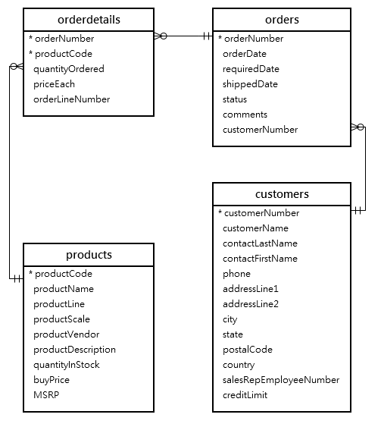
Challenge!
Take a look at the image on the right; it shows us how the tables for orders, orderdetails, customers, and products are related in the "classicmodels" database.
Problem statement: Write a query to display the customer number, customer name, order number, order date, product code, product name, and price.
You can use the JOIN, GROUP By, and HAVING clauses.

Slide 18
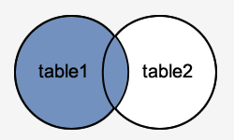
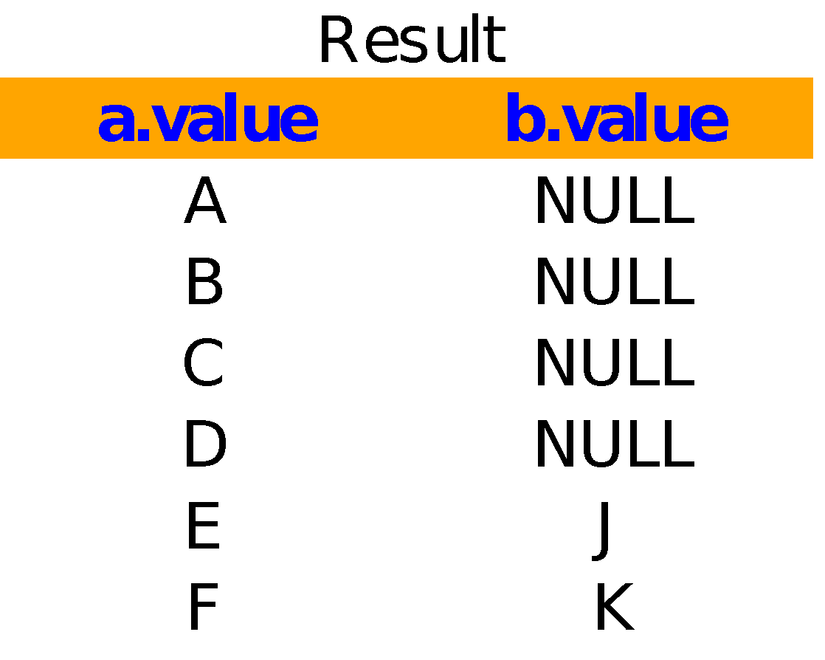
Overview of LEFT JOIN Clause
In a LEFT JOIN, all rows from the left table are guaranteed to be represented in the result set whether or not a row from the right table is found to satisfy the predicate.
When no matching row from the right table is found, those fields will be NULL:
Visual illustration
img src: databasestar.com
select a.value, b.value from TableA a LEFT JOIN TableB b on a.id=b.id;
left join
on a.id=b.id

Slide 19
Using LEFT JOIN
One common usage for LEFT JOIN is to count records for which there is no match. Consider our previous example:
select count(*) from A a left join B b using(id) where b.value is NULL;
This query returns 4 rows – there are 4 unmatched rows between the tables.
Remember that we also use JOINS in succession. When the results of a LEFT JOIN flows into another JOIN, we are guaranteed that all rows from the left-most table will be represented. If we use LEFT JOINS in succession, we are guaranteed that the final result set will have all rows of the left-most table represented.
When we use COUNT(*) with GROUP BY, we often want to include groups with a count of zero. LEFT JOIN lets us do this.

Slide 20
Syntax - LEFT JOIN
The syntax for the LEFT JOIN in SQL is:
SELECT columns
FROM table1
LEFT JOIN table2
ON table1.column_name = table2.column_name;
You can use the USING keyword syntax like this:
SELECT columns
FROM table1
LEFT JOIN table2
USING(column_name);

Slide 21

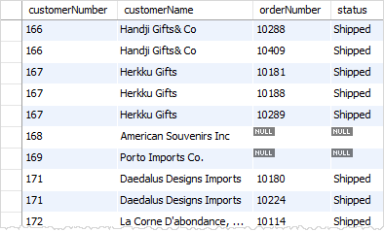
Example 1: LEFT JOIN Clause - Join Two Tables
Let’s take a look at the image on the right, which shows the customers and orders tables.
Each order in the orders table must belong to a customer in the customers table.
Each customer in the customers table can have zero or more orders in the orders table.
To find all customers regardless of their order status, you can use the LEFT JOIN clause:
SELECT c.customerNumber, c.customerName, o.orderNumber, o.status
FROM customers c
LEFT JOIN orders o ON c.customerNumber = o.customerNumber;
This image shows the partial output:

Slide 22
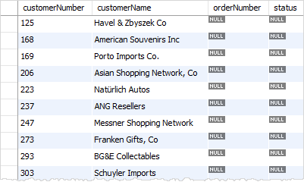
Example 2: LEFT JOIN Clause - Find Unmatched Rows
The LEFT JOIN clause is very useful when you want to find the rows in the left table that do not match with the rows in the right table. To find the unmatched rows between two tables, you add a WHERE clause to the SELECT statement to select only rows whose column values in the right table contain the NULL values.
For example, to find all customers who have not ordered any products, you can use the following query:
This image shows the partial output.
SELECT c.customerNumber, c.customerName, orderNumber, o.STATUS
FROM customers c
LEFT JOIN orders o ON c.customerNumber = o.customerNumber
WHERE orderNumber IS NULL;

Slide 23
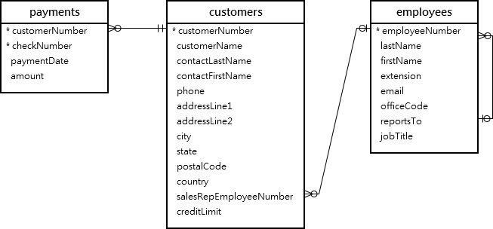
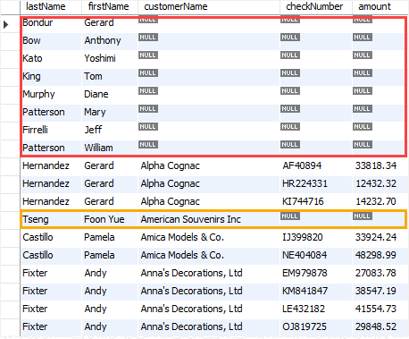
Example 3: LEFT JOIN Clause - Find Unmatched Rows
Take a look at the right-hand figure, which shows how the tables for employees, customers, and payments are related in the "classicmodels" database.
The below query uses two LEFT JOIN clauses to join the three tables: employees, customers, and payments.
SELECT lastName, firstName, customerName, checkNumber, amount
FROM employees
LEFT JOIN customers ON
employeeNumber = salesRepEmployeeNumber
LEFT JOIN payments ON
payments.customerNumber = customers.customerNumber
ORDER BY customerName, checkNumber;
Output:
Notes:
How it works.
The first LEFT JOIN returns all employees and customers who represented each employee or NULL if the employee does not in charge of any customer.
The second LEFT JOIN returns payments of each customer represented by an employee or NULL if the customer has no payment.

Slide 24
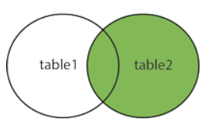
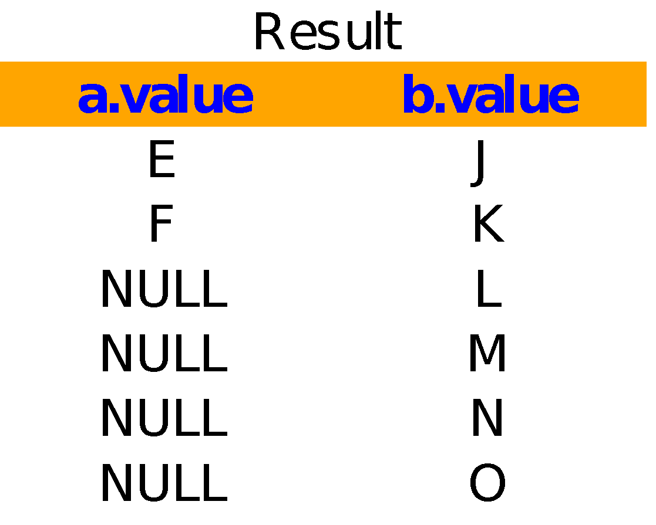
Overview of RIGHT JOIN Clause
RIGHT JOIN is similar to LEFT JOIN, except that the treatment of the joined tables is reversed.
In a RIGHT JOIN, all rows from the right table are guaranteed to be represented in the result set, whether or not a row from the left table is found to satisfy the predicate.
When no matching row from the left table is found, those fields will be NULL:
Visual illustration
img src: databasestar.com
select a.value, b.value from TableA a RIGHT JOIN TableB b ON a.id=b.id;
right join
on a.id=b.id

Slide 25
Syntax - RIGHT JOIN
The syntax for the RIGHT JOIN in SQL is:
SELECT columns
FROM table1
RIGHT JOIN table2
ON table1.column_name = table2.column_name;
You can use the USING syntax like this:
SELECT columns
FROM table1
RIGHT JOIN table2
USING(column_name);

Slide 26
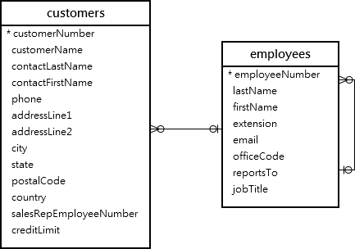
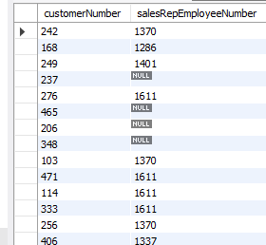
Example 1: Right JOIN Clause - Join Two Tables
Take a look at the image on the right; it shows how the tables for employees and customers are related in the "classicmodels" database.
The column salesRepEmployeeNumber foreign key in the customers table links to the column employeeNumber in the employees table.
A sales representative, or an employee, may be in charge of zero or more customers, and each customer is taken care of by zero or one sales representative.
If the value in the column salesRepEmployeeNumber is NULL, this means that the customer does not have a sales representative.
SELECT customerNumber, salesRepEmployeeNumber
FROM employees
RIGHT JOIN customers
ON employeeNumber = salesRepEmployeeNumber
ORDER BY customerName;
Notes:
In this example:
The RIGHT JOIN returns all rows from the table employees whether rows in the table employees have matching values in the column salesRepEmployeeNumber of the table customers.
If a row from the table employees has no matching row from the table customers , the RIGHT JOIN uses NULL for the customerNumber column.

Slide 27
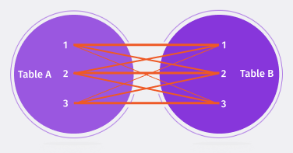
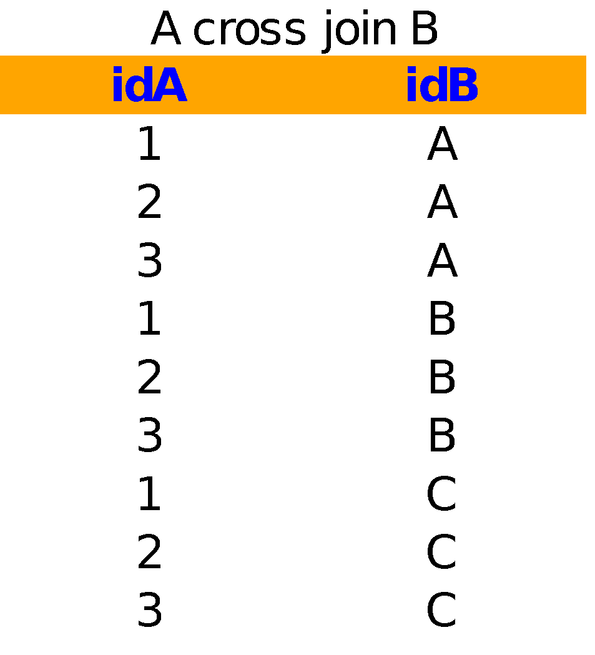
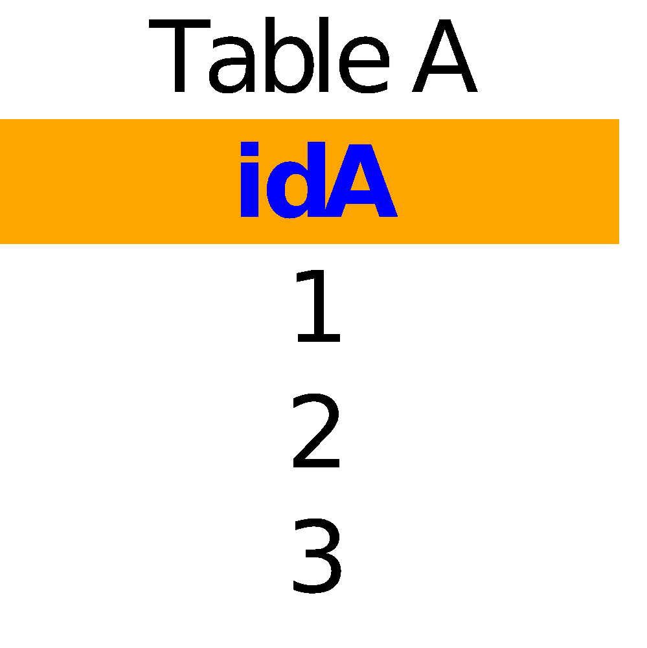
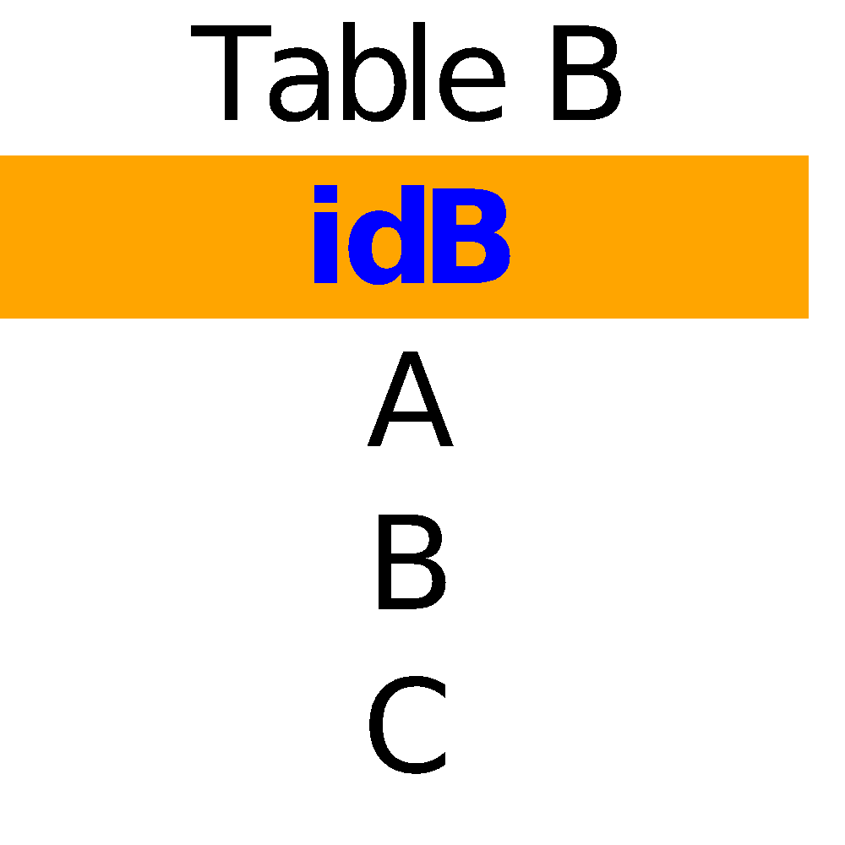
Overview of CROSS JOIN Clause
The CROSS JOIN is an unfiltered join – it uses a no join predicate. The output of a CROSS JOIN is a cartesian product – every possible combination of rows are in the left and right tables.
select * from
cross join
3 rows
3 rows
9 rows
img src: databasestar.com
CROSS JOIN produces a result set, which is the number of rows in the first table multiplied by the number of rows in the second table.
CROSS JOIN on very large tables can generate a huge result set.
continue…

Slide 28
Overview of CROSS JOIN Clause (continued)
The following illustrates the syntax of the CROSS JOIN clause that joins two tables: t1 and t2:
SELECT * FROM t1
CROSS JOIN t2;
The CROSS JOIN clause does not have a join predicate. In other words, it does not have the ON or USING keyword.
If you add a WHERE clause in case table t1 and t2 have a relationship, the CROSS JOIN works like the INNER JOIN clause as shown in the following query:
SELECT * FROM t1
CROSS JOIN t2
WHERE t1.id = t2.id;
Notes:
Note: CROSS JOIN does not itself apply any predicate to filter rows from the joined table. The results of a CROSS JOIN can be filtered using a WHERE clause, which may then produce the equivalent of an inner join.
In the SQL:2011 standard, cross joins are part of the optional, "Extended joined table", package.
Normal uses are for checking the server's performance.

Slide 29
Example: CROSS JOIN Clause
The example below uses the CROSS JOIN Clause to join customers with payments:
SELECT * FROM customers e
CROSS JOIN payments p;

Slide 30
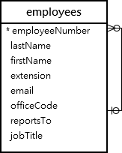
Overview of SELF JOIN
There is no SELF JOIN keyword, We just write an ordinary join where both tables involved in the join are the same table
A SELF JOIN allows you to join a table to itself. It helps to query hierarchical data or compare rows within the same table.
Some tables define a foreign key to their own primary key. A common scenario is an employee table, where each row includes a foreign key to the employee’s manager, who is also an employee.
Note: SELF JOINS require the use of a table alias to distinguish the field names.

Slide 31
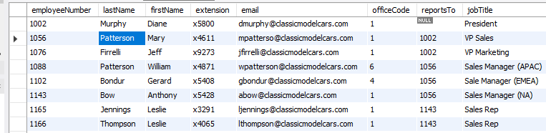
Overview of SELF JOIN (continued)
Take a look at the image on the right; this is the employees table from the classicmodels database.
The employees table stores not only employee data but also the organizational structure data. The reportsTo column is used to determine the manager id of an employee.
For example, Patterson reports to Murphy because the value in the reportsTo column of Patterson is 1002 (Murphy).
Murphy has no manager, so the reportsTo column has a NULL value, as shown below:
Notes:
One thing to notice is that when you are self joining it is necessary to use an alias for the table otherwise the table name would be ambiguous.

Slide 32
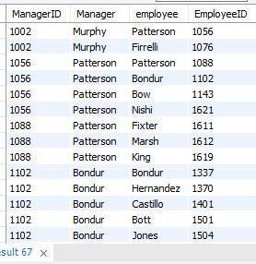
Example 1: SELF JOIN
You can use the SELF JOIN to determine who reports to whom; to do so, we can use the INNER JOIN.
SELECT m.employeeNumber AS ManagerID, m.lastName AS Manager, e.lastName AS 'employee', e.employeeNumber AS EmployeeID
FROM employees e
INNER JOIN employees m ON m.employeeNumber = e.reportsTo
ORDER BY m.employeeNumber;
In this example, we referenced the employees table twice; once as e for the employees and the other as m for the managers. The JOIN predicate matches the employee and manager relationship using the values in the m.employeeNumber = e.reportsTo.
continue…
Notes:
One thing to notice is that when you are self joining it is necessary to use an alias for the table otherwise the table name would be ambiguous.

Slide 33
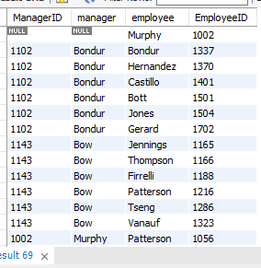
Example 1: SELF JOIN (continued)
Note: in the previous image that the employees column does not include Murphy; this is because of the INNER JOIN effect. If you replace the INNER JOIN clause by the LEFT JOIN clause as shown in the following query, you will get the result set that includes Murphy in the employee column:
SELECT m.employeeNumber as ManagerID, m.lastName manager, e.lastName employee, e.employeeNumber as EmployeeID
FROM employees e
LEFT JOIN employees m
ON m.employeeNumber = e.reportsTo
ORDER BY manager;

Slide 34
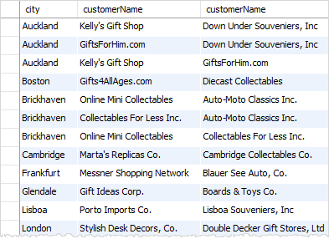
Example 2: SELF JOIN - Compare Successive Rows
By using the SELF JOIN, you can display a list of customers who are located in the same city by joining the customers table to itself.
SELECT c1.city, c1.customerName, c2.customerName
FROM customers c1
INNER JOIN customers c2
ON c1.city = c2.city
AND c1.customername > c2.customerName
ORDER BY c1.city;
In this example, the table customer is joined to itself using the following JOIN conditions:
c1.city = c2.city makes sure that both customers have the same city.
c.customerName > c2.customerName ensures that no same customer is included.

Slide 35
Overview of FULL JOIN Clause
The FULL JOIN Clause combines the effects of left and right JOINS – all rows of both left and right tables are guaranteed to appear in the result set, regardless of whether the JOIN predicate is satisfied or not.
When any row from either table fails to satisfy the JOIN condition, NULL values will appear in the output:
Notice: MySQL does not support FULL JOIN, but the same result is achieved using UNION operator.

Slide 36
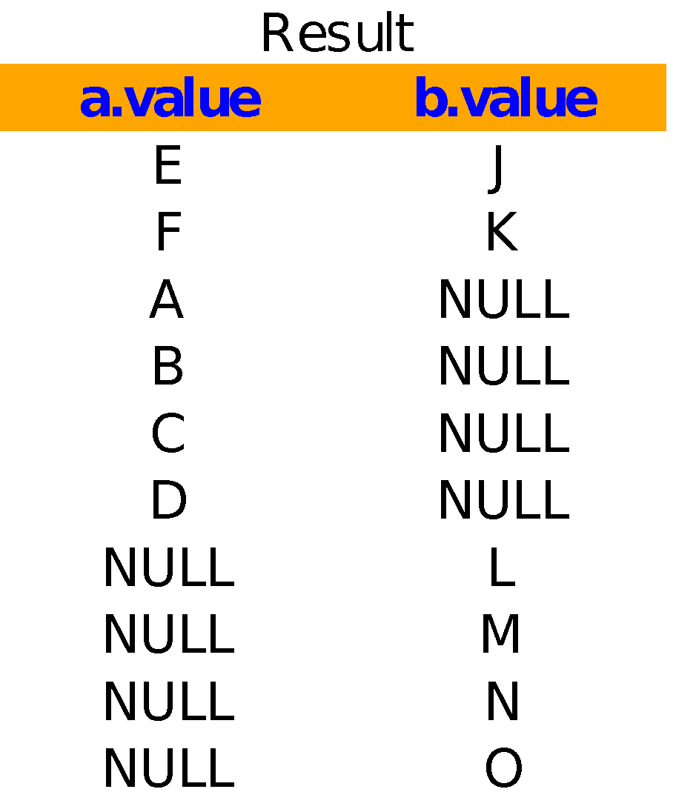
Overview of Union Operator
The UNION operator allows you to combine two or more result sets of queries into a single result set. The following illustrates the syntax of the UNION operator:
SELECT column_list
UNION [DISTINCT | ALL]
SELECT column_list
UNION [DISTINCT | ALL]
SELECT column_list
select a.value, b.value from a left join b using(id)
union
select a.value, b.value from a right join b using(id);

Slide 37
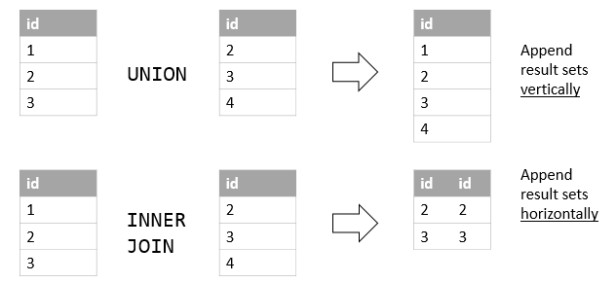
UNION Operator vs. JOIN Clause
A JOIN combines a result set horizontally; whereas a UNION appends a result set vertically. The following illustration shows the difference between UNION and JOIN:
img src: devart.com

Slide 38
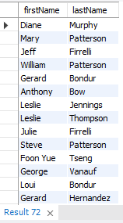
Example: Union Operator
We will use the customers and employees tables for this demonstration.
Suppose you want to combine the first name and last name of employees and customers into a single result set. To do this, you can use the UNION operator:
SELECT firstName, lastName
FROM employees
UNION
SELECT contactFirstName, contactLastName
FROM customers;

Slide 39
Joining Without JOIN
Joins can be achieved without the JOIN keyword by using the WHERE clause to define the join predicate.
select a.value, b.value from A a, B b
where a.id=b.id;
This style of joining is called “Theta Style.” A Theta Style is a JOIN that links tables based on a relationship other than equality between two columns. A Theta Style could use any operator other than the “equal” operator.
The JOIN keyword offers distinct advantages over Theta Style join
The left and right tables are clear
Left, right, and full joins are possible.
“Using” keyword syntax is possible.

Slide 40
Hands-On Lab
Complete the following Labs. You can find them on Canvas under the Assignment section.
GLAB - 304.6.1 - Joins and Clauses - Classicmodels Database
GLAB - 304.6.2 - Joins and Clauses - Banking Database
If you have any technical questions while performing the lab activity, ask your instructors for assistance.

Slide 41
Practice Assignments
Complete the following practice assignments:
The JOIN operation
JOIN and clauses
Self join
SQL JOINS - Exercises, Practice, Solution - JOINS
2. Complete the following practice assignments (administered through HackerRank).
Population Census
African Cities
The PADs
Note: Use your office hours to complete this assignment. If you have any technical questions while performing the assignment activity, ask your instructors for assistance.

Slide 42
Check Your Knowledge
What Are SQL JOINs?
What are the different types of JOINS in SQL?
How can you join a table to itself?

Slide 43
Summary
In this presentation, we discussed JOIN queries, which allow us to walk through the relationships between two or more tables in the FROM clause. JOINS are queries that combine the data of multiple tables based on their common columns and constraints to produce a combined result set:
A JOIN implemented without any other modifiers is by default an INNER JOIN.
A Right JOIN returns all records from the right table, and the matched records from the left table; while a Left JOIN returns all records from the left table and the matched records from the right table
An INNER JOIN returns records that have matching values in both tables.
A CROSS JOIN produces a result set, which is the number of rows in the first table, multiplied by the number of rows in the second table.
A SELF JOIN returns a table that is joined with itself.
A JOIN implemented without the JOIN keyword is called Theta Style.

Slide 44
References
https://en.wikipedia.org/wiki/Join_(SQL)
https://www.techonthenet.com/mysql/group_by.php
https://www.techonthenet.com/mysql/between.php

Slide 45

Questions ?
‹#›

